Slide 1
Artificial Intelligence
Chapter 6: Constraint Satisfaction Problems (CSP)
This chapter describes a way to solve a wide variety of problems more efficiently. A factored representation is used with a set of variables. Then, the problem is solved when each variable has a value that satisfies all the constraints.
Instructor: Zakariya Ahmed Oraibi
University of Basrah, Iraq

Slide 2
CSP
A CSP is defined by a set of variables: X1, X2, ……, Xn, in addition to a set of constraints: C1, C2, ………, Cm.
Each variable Xi has has a nonempty domain of Di possible values.
A solution to a CSP is a complete assignment of values to all variables that satisfies all the constraints.

Slide 3
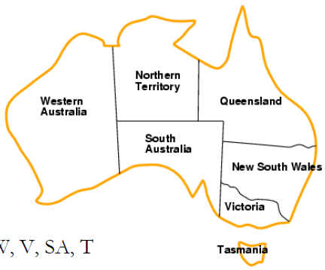
CSP
Example 1: Map Coloring
Variables: WA, NT, Q, NSW, V, SA, T.
Domains: {red, green, blue}.
Constraints: adjacent regions must have different colors e.g., WA ≠ NT.
Solutions are complete and consistent assignments, e.g., WA = red, NT = green, Q = red, NSW = green, V = red, SA = blue, T =
green.

Slide 4
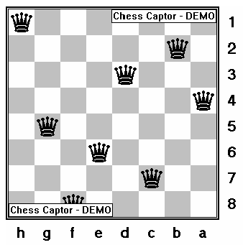
CSP
Example 2: n-queen
Variables: Q1, …., Qn.
Domains: the set {1, ...,n}.
Constraints: no queen Qi threaten the others.

Slide 5
CSP: Algorithms
CSP can be solved by a standard search method as follows:
Initial state: the empty assignment {}, in which all variables are unassigned.
Successor function: a value can be assigned to any unassigned variable, provided
that it does not conflict with previously assigned variables.
Goal test: the current assignment is complete.
Path cost: a constant cost (e.g., 1) for every step.

Slide 6
CSP: Algorithms
Backtracking Search for CSP:
- Uses Depth-First search.
- Chooses values for one variable at a time and backtracks when a variable has no legal values left to assign.

Slide 7




CSP: Algorithms: Backtracking Example
?
?
…………

Slide 8
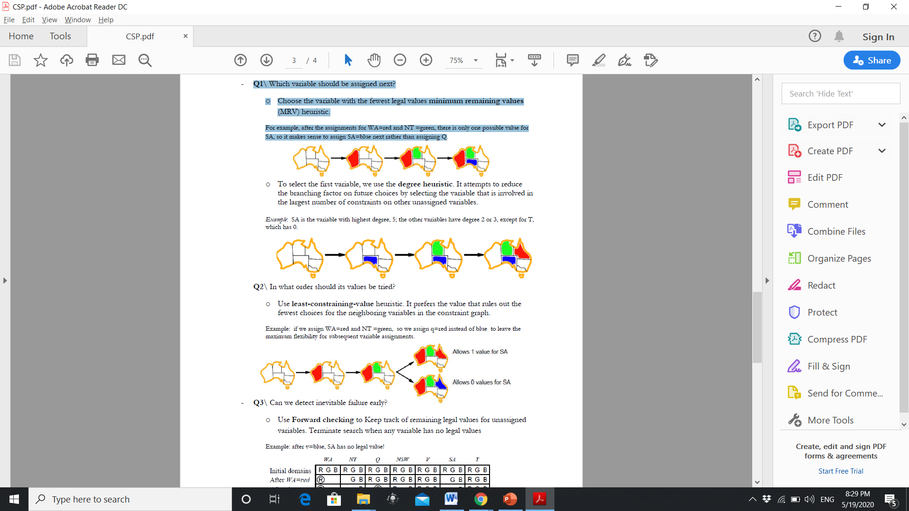
CSP: Algorithms
Improving backtracking efficiency:
Q1\ Which variable should be assigned next?
o Choose the variable with the fewest legal values minimum remaining values (MRV) heuristic.
For example, after the assignments for WA=red and NT =green, there is only one possible value for
SA, so it makes sense to assign SA=blue next rather than assigning Q.
MRV = 2 for Q
MRV = 1 for SA

Slide 9
CSP: Algorithms
Improving backtracking efficiency:
Q1\ Which variable should be assigned next?
o To select the first variable, we use the degree heuristic: the variable that is involved in
the largest number of constraints on other unassigned variables.
SA is the variable with highest degree, 5.

Slide 10
CSP: Algorithms
Improving backtracking efficiency:
Q2\ In what order should its values be tried?
o Use least-constraining-value heuristic.
Example: if we assign WA=red and NT =green, so we assign q=red instead of blue to leave the
maximum flexibility for subsequent variable assignments.
Called Failure

Slide 11
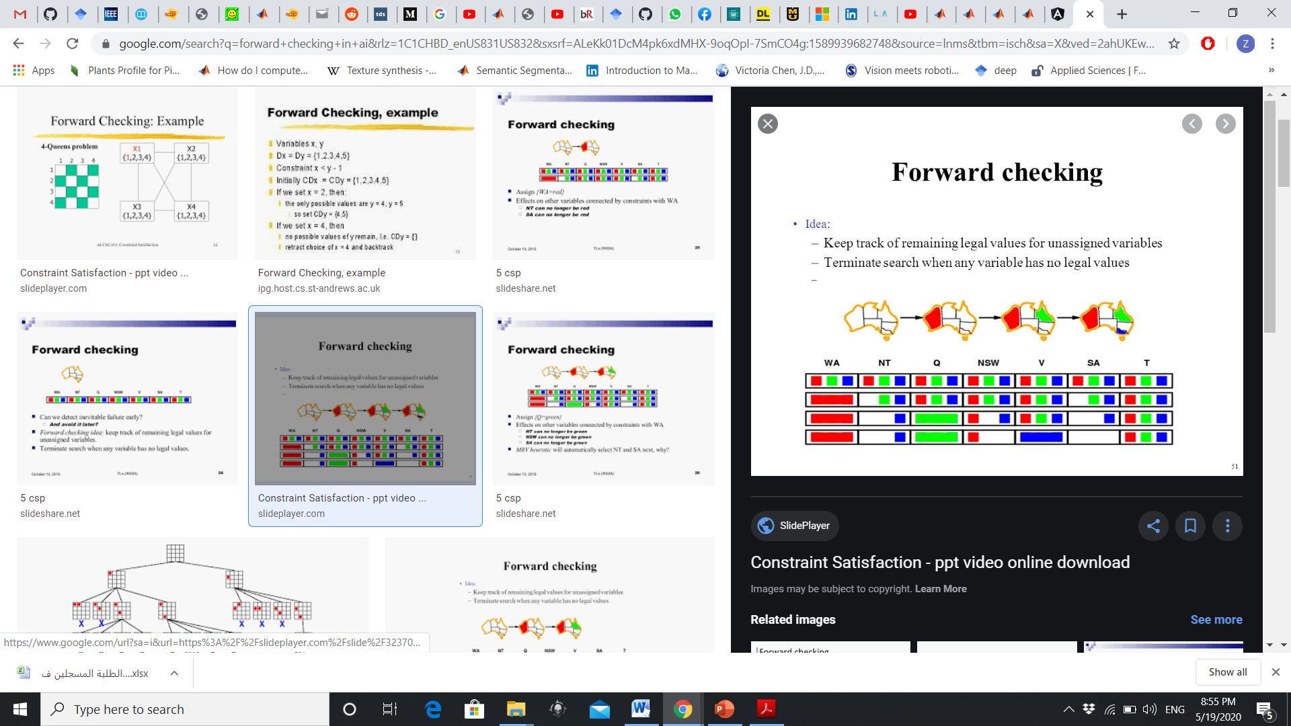
CSP: Algorithms
Improving backtracking efficiency:
Q3\ Can we detect inevitable failure early?
o Use Forward checking:
- Keep track of remaining legal values for unassigned variables.
- Terminate search when any variable has no legal values.

Slide 12
CSP: Algorithms
Improving backtracking efficiency:
Q3\ Can we detect inevitable failure early?
o Use Forward checking:
- Keep track of remaining legal values for unassigned variables.
- Terminate search when any variable has no legal values.
Assign WA = red

Slide 13
CSP: Algorithms
Improving backtracking efficiency:
Q3\ Can we detect inevitable failure early?
o Use Forward checking:
- Keep track of remaining legal values for unassigned variables.
- Terminate search when any variable has no legal values.
Assign Q = green

Slide 14
CSP: Algorithms
Improving backtracking efficiency:
Q3\ Can we detect inevitable failure early?
o Use Forward checking:
- Keep track of remaining legal values for unassigned variables.
- Terminate search when any variable has no legal values.
If V = blue

Slide 15
CSP: Algorithms
Improving backtracking efficiency:
Q3\ Can we detect inevitable failure early?
o Constraint Propagation:
- Forward Checking doesn’t provide detection for all failures.
- Constraint Propagation repeatedly enforces constraints locally.
- The method is called Arc Consistency.
* X Y is consistent iff
for every value of X there is some allowed value of Y.
* SA NSW is consistent iff
SA = blue and NSW = red

Slide 16
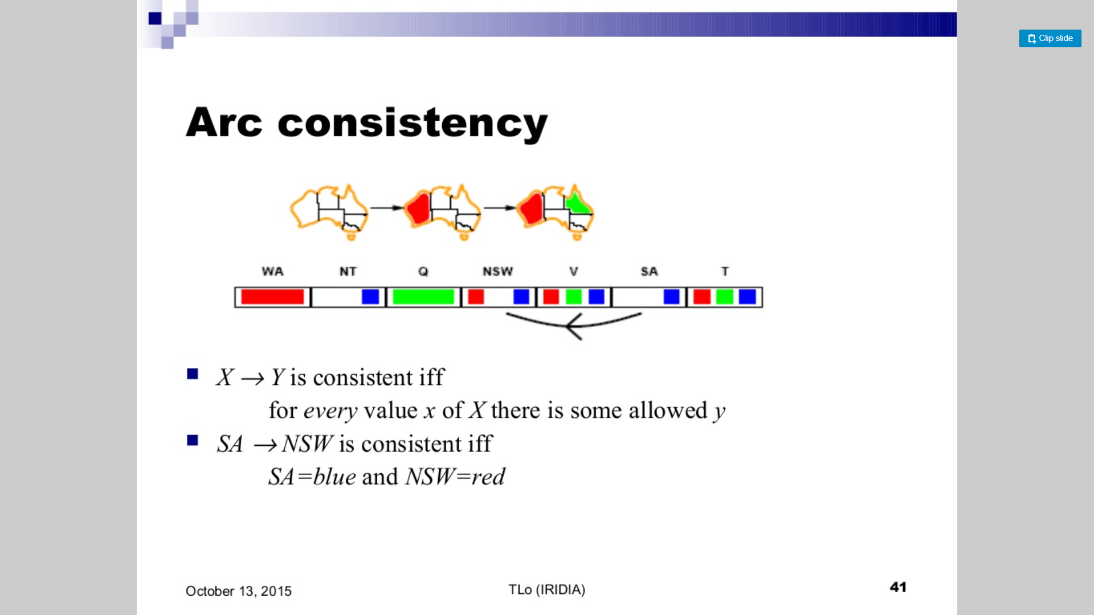
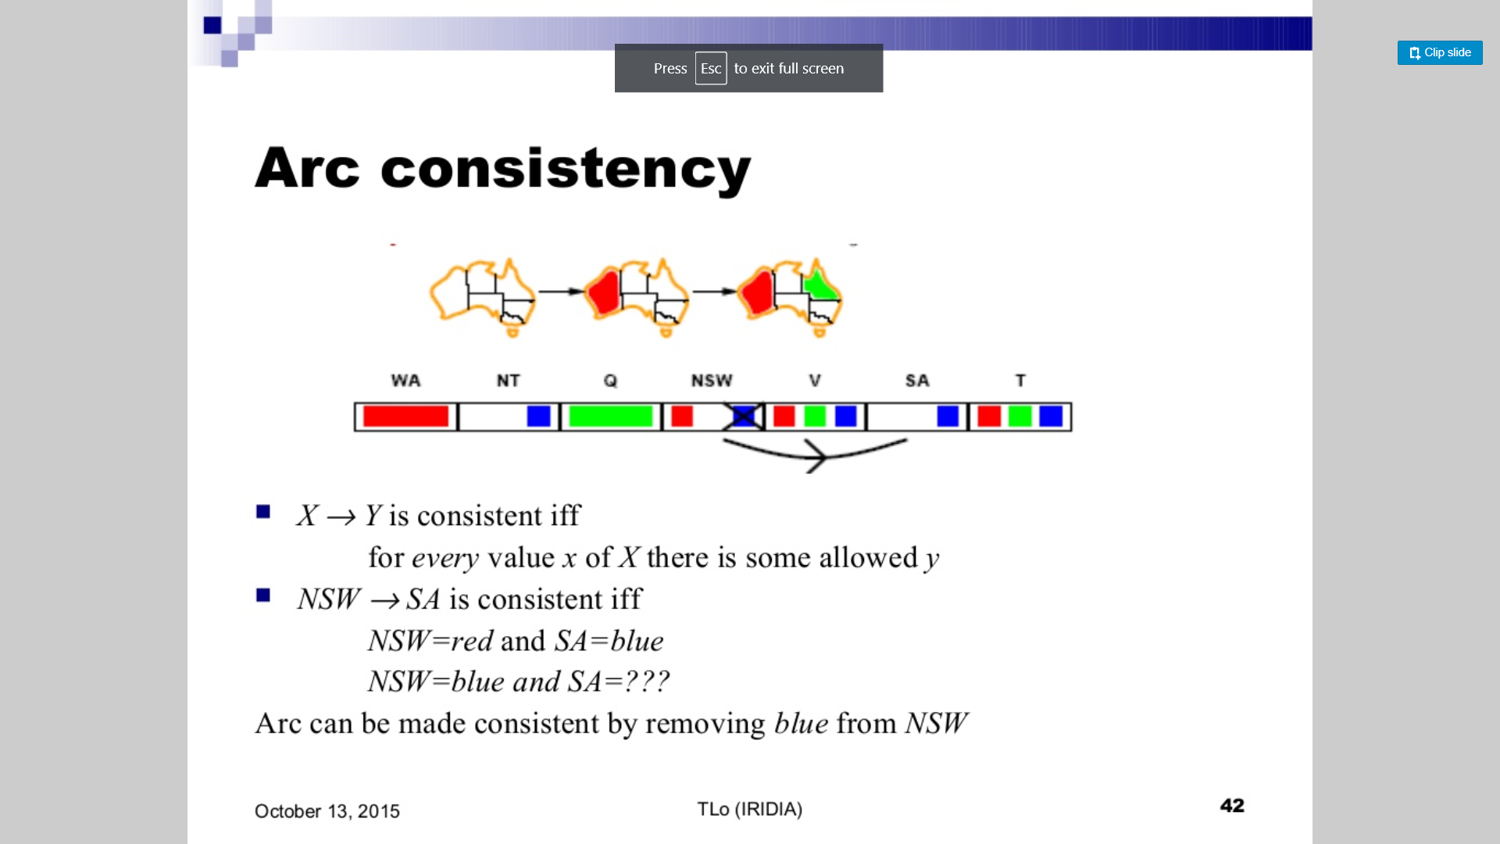
CSP: Algorithms
Improving backtracking efficiency:
Arc Consistency.
* SA NSW is consistent iff
SA = blue and NSW = red
Arc Consistency.
* NSW SA is consistent iff
NSW = red and SA = blue
remove blue from NSW to ensure arc consistency.

Slide 17
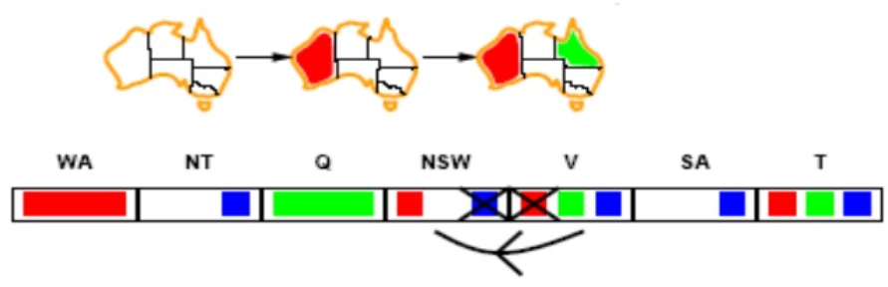
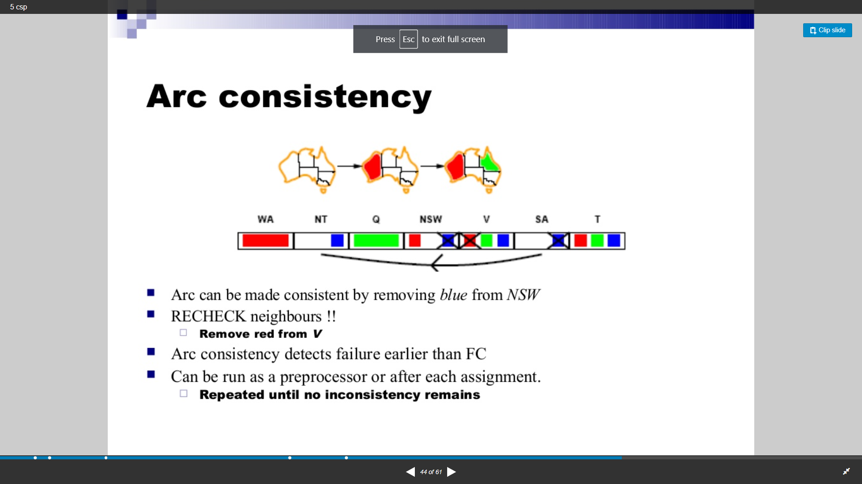
CSP: Algorithms
Improving backtracking efficiency:
Arc Consistency.
Now recheck neighbors:
Remove red from V
Arc consistency detects failure earlier than Forward Checking.

Slide 18
Thank You

